Slide 1

SOEN 6441 Advanced Programming Practices
RISK
Presented by:
Rohit
Raghav
Ishaan
Sumit
Kevin
Bhavya

Slide 2
Table of Contents:
Introduction
Goal of the project
Architectural Diagram
Functional Description
Tools used

Slide 3
Introduction
In this project we are building a computer battle game, ”Risk” based on the functionality of Warzone game where the main goal of the game is to own all the territories of the map. The map is a connected graph with countries as nodes and edges between the nodes represent the adjacency of the countries. The game starts with the startup phase where the number of players are determined, and the territories are randomly allocated among the players. The game is turn based where the players first issue the orders and then they are executed.

Slide 4
Goal of the Project
The main goal of the project is to build a battle game where the player who owns all the territories wins.
Implementation of the Warzone Engine which is initiated by the Game Engine to control game phase.
Implementation of the startup phase where the game begins with the selection of a user-saved map file, loading it as a connected directed graph.
Load the existing map
Edit the map
Create a new map
Validate
The territories are allocated to the players randomly.
In the Startup phase of the game, the players can
Issue orders
Execute orders

Slide 5
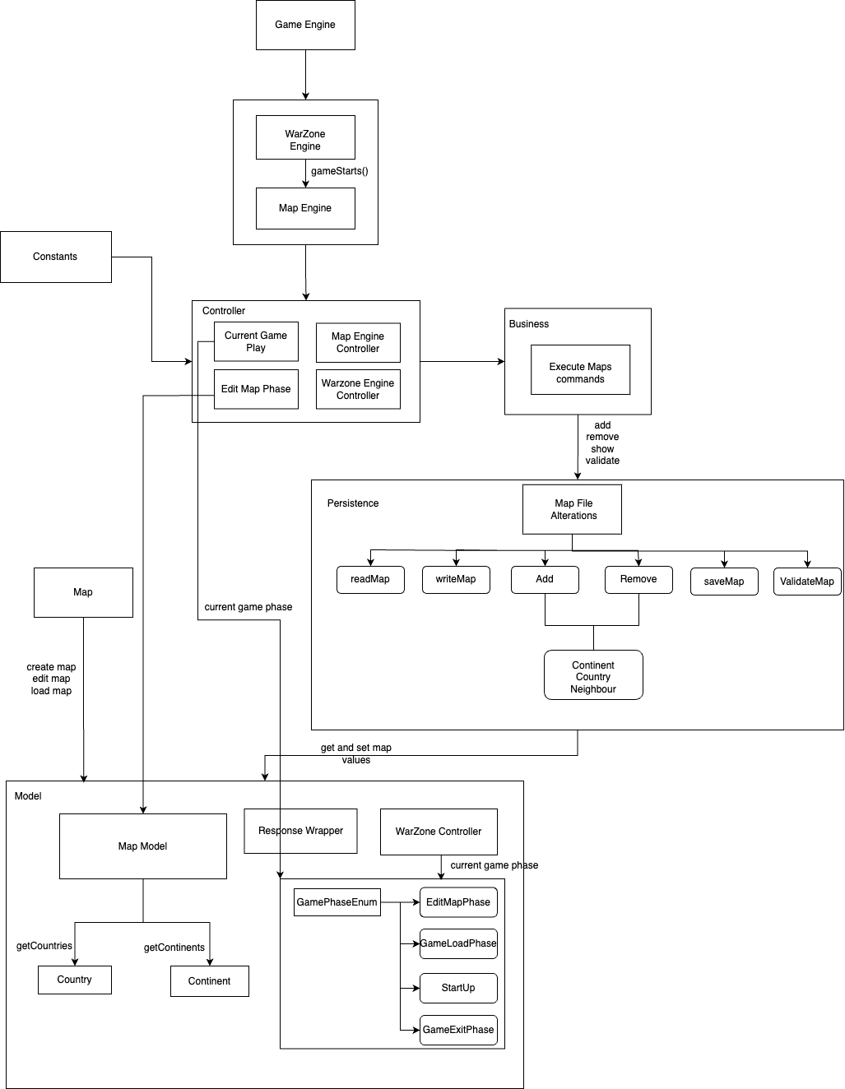
Architectural Diagram

Slide 6
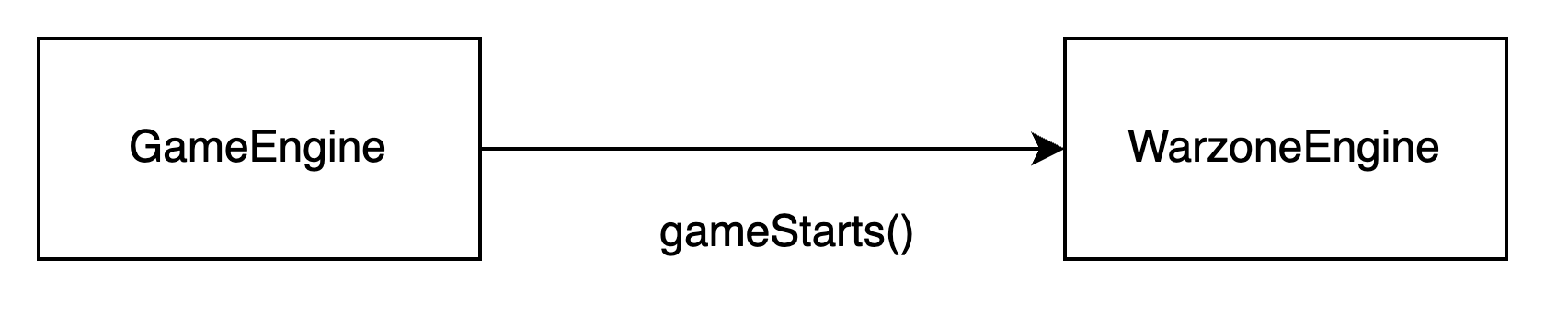
Functional Description
GameEngine
The purpose of this class is to initialize and start a game engine.

Slide 7
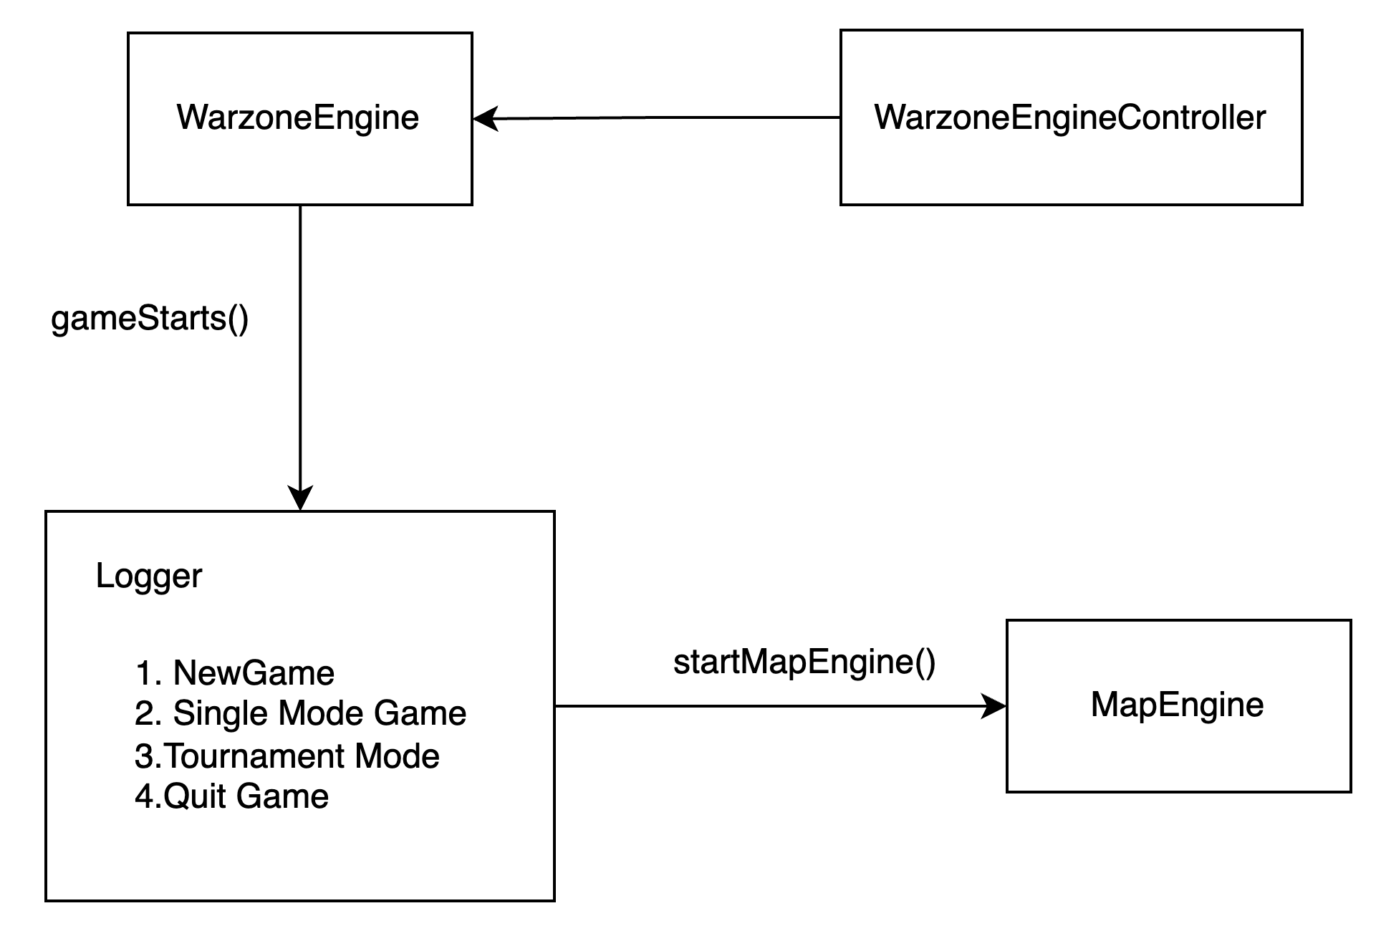
Warzone Engine
The WarzoneEngine class serves as the entry point for a game, initializing game components, managing user input, and controlling game state transitions, including interactions with the map engine and logging.

Slide 8
MapEngine and MapEngineController
These classes manage the map-related commands and interactions. It allows users to perform actions such as:
Create New Map
Edit Existing Map by adding or removing
Continents
Countries
Neighbours
Show Map
Validate Map
They maintain a user interface through console logs and follows a loop-based structure to receive and process map-related commands from users.

Slide 9
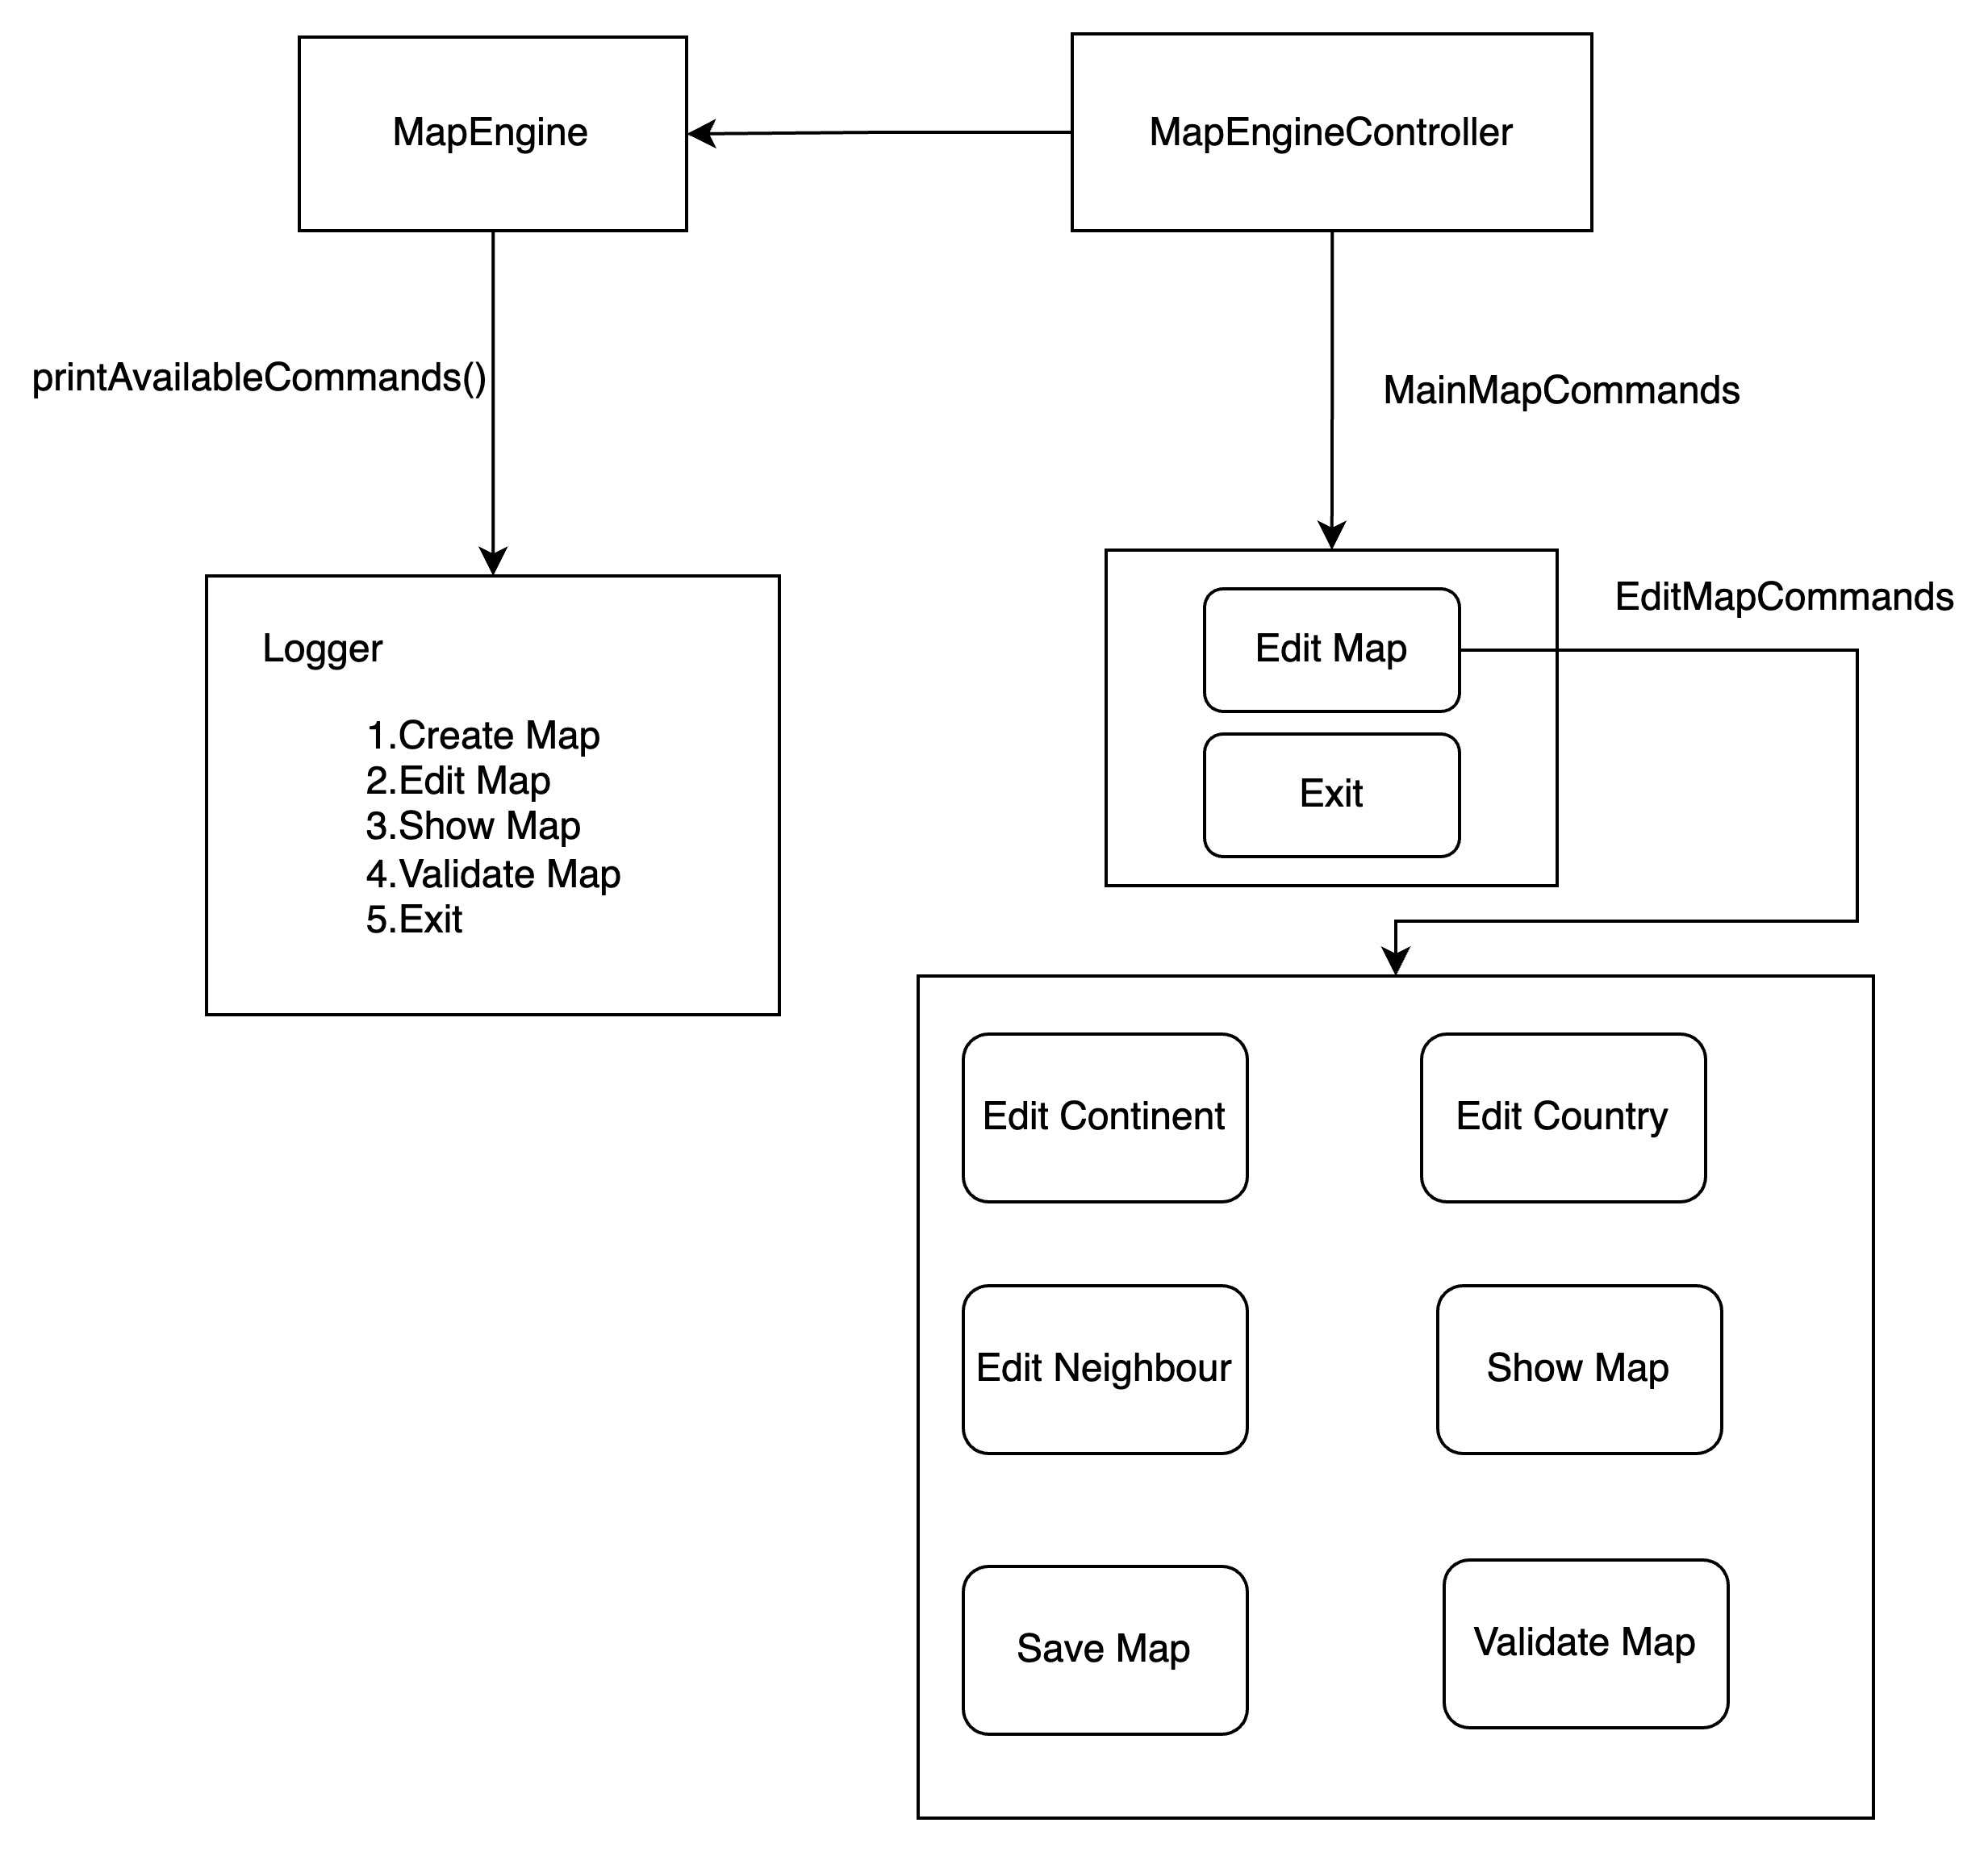
MapEngine and MapEngineController

Slide 10
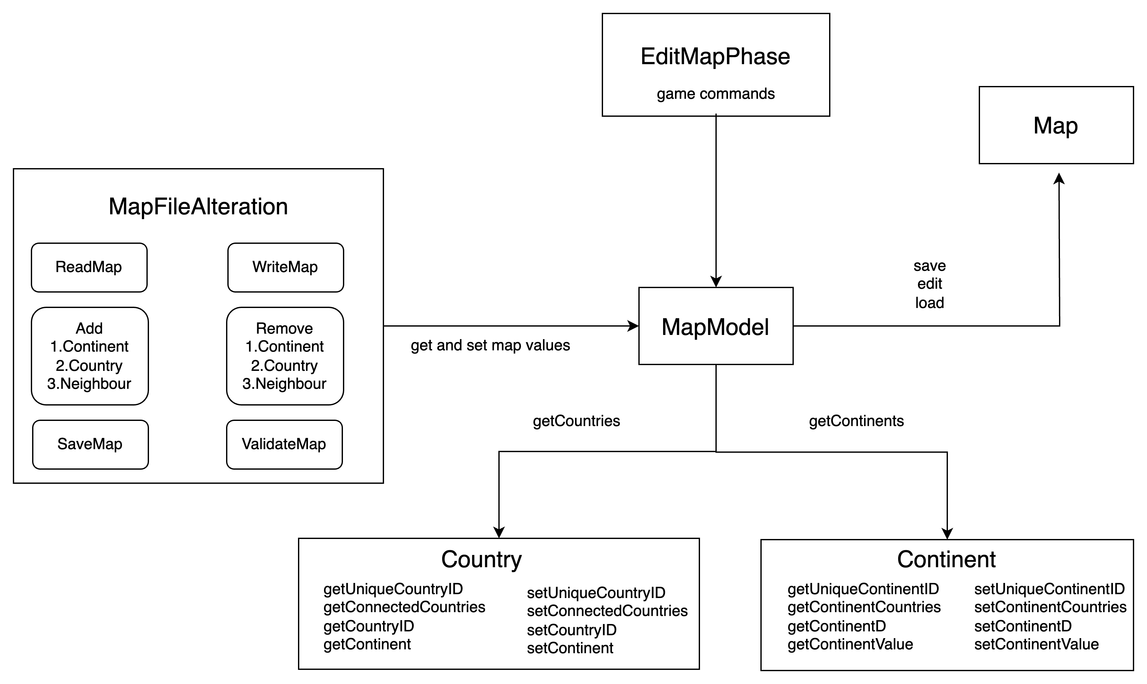
MapModel

Slide 11
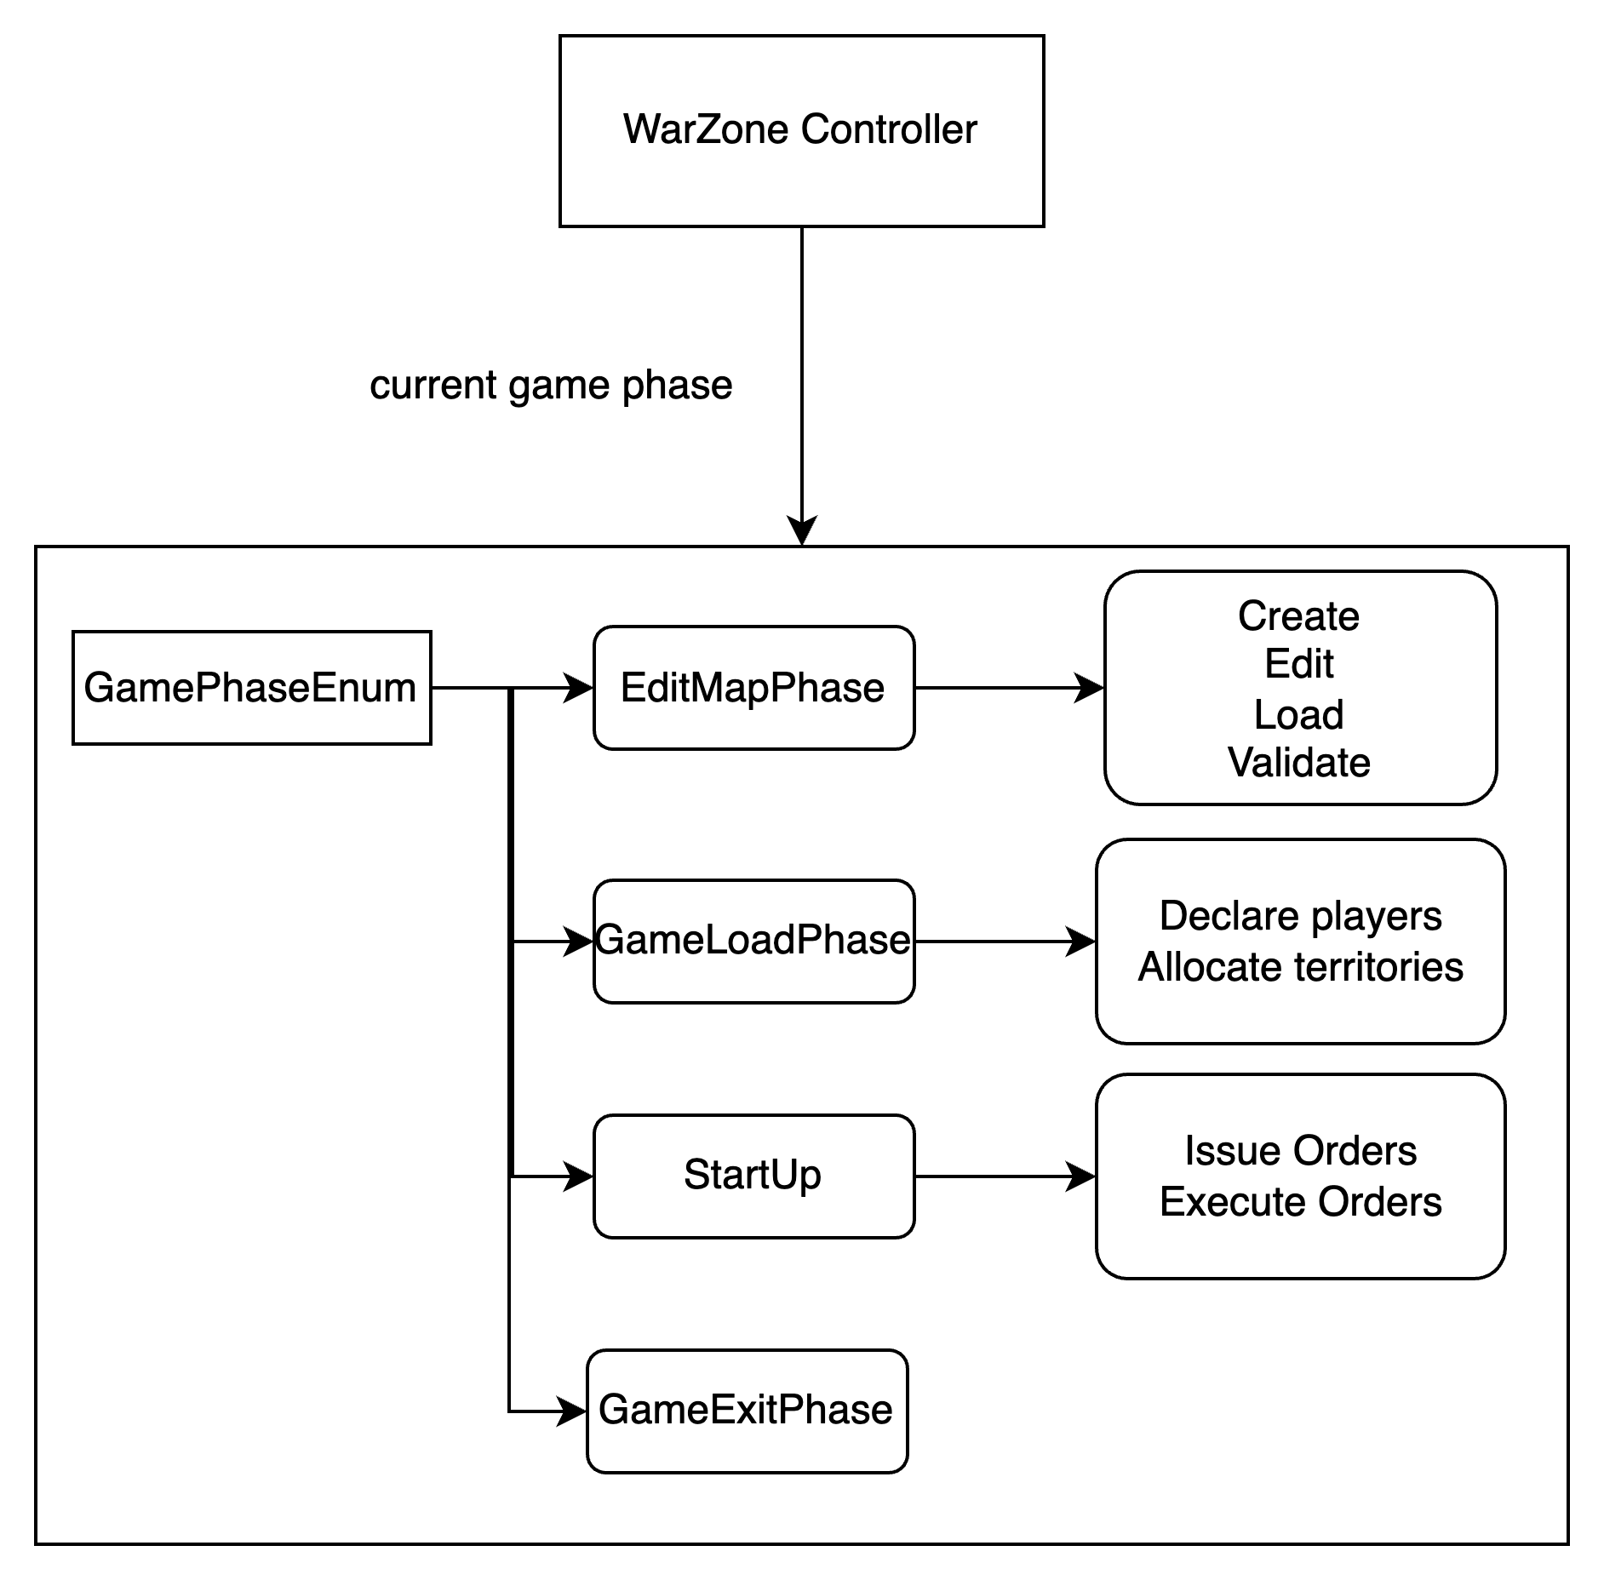
GamePhaseEnum

Slide 12
Tools used
GitHub
Version control and collaboration
Repository setup and cloning
Collaboration with team members
Git commands for branching, committing, and pushing
Eclipse IDE
Integrated Development Environment
Project setup and coding
Running JUnit tests
Debugging and Git integration
Javadoc
Code documentation with comments
Generating Javadoc in Eclipse
Clear code documentation for classes and methods
JUnit
Unit testing framework
Writing test classes with annotations
Running tests and using assertions

Slide 13
Coding conventions followed
Naming conventions
class names in CamelCase that starts with a capital letter
data members start with d_
method parameters start with p_
local variables start with l_
global variables in capital letters
static members start with a capital letter, non-static members start with a lower case letter
Code layout
consistent layout throughout code (use an IDE auto-formatter)
Commenting convention
javadoc comments for every class and method
long methods (more than 10 lines) are documented with comments for procedural steps
no commented-out code
Project Structure
one folder for every module in the high-level design
tests are in a separate folder that has the exact same structure as the code folder
1-1 relationship between tested classes and test classes

Slide 14
Thank you

